Slide 1
STATUS REPORT
Big Bang

Slide 2
ISSUES | Big Bang Status Report
Data Capture Team
Monitoring & Evaluation Team
Development Team

Slide 3
Issues
After reviewing the input and output forms by the client, modification of the forms was needed
Delay in the User Manual due to revisions in the website
Data Capture Team

Slide 4
Issues
Scheduling meetings with M&E manager
Communications delays
Last minute changes to the forms
Monitoring & Evaluation Team

Slide 5
Issues
Too many PMs in BPAP
Integration (back and front end of the system)
Lack of manpower. (Only few are able to code in MySQL)
After reviewing the input and output forms by the client, modification of the forms are needed
Data needed from the client are difficult to acquire
Development Team

Slide 6
ADDRESSING THE ISSUES
Big Bang Status Report

Slide 7
Addressing the Issues
Dev team is undergoing additional training and consultation
Modified the input and output forms according to instructions
Follow up with the respective people religiously
Work over time to reallocate the resources & tasks and make up for lost time
Assemble the project team and work on the changes together
Scheduled meeting between the client and the project team will be rescheduled
Reschedule the project tasks that are to be accomplished immediately

Slide 8
DELIVERABLES
Big Bang Status Report

Slide 9
Deliverables
Final Versions of the Input Data Forms BEST, AdEPT and SMP
Proposed Logical Data Flow
Proposed Physical Data Flow
Data Dictionary
ERD
Logical Data Map
System Design Approval
Final Version of User Manual

Slide 10
Current status
Big Bang Status Report

Slide 11
Currently…
System development is on going full blast. (Expected demo for the working prototype on first week of January)
Forms and outputs have been presented to M&E, PDT, with approval
Final comments for the system design were collected

Slide 12
TEAM PLANS
Big Bang Status Report

Slide 13
Team Plans
Team Plans
Data Capture &
M&E Team
Development Team

Slide 14
Team Plans
Data Capture Team
&
M&E Team
Creation of User Manual
Print out physical copies of forms and reports templates
Documentation for Reports
Support in creation of test cases, database queries

Slide 15
Team Plans
Full throttle in system development
Finalization of the user interface
Finish backend development by Dec. 22
Consultations with Sir Doy as the development progresses.
UI
Functions
Development Team
Notes:
Full throttle in system development
Finalization of the user interface
Finish backend development by Dec. 22
Consultations with Sir Doy as the development progresses.
UI
Functions

Slide 16
Team Plans
Demo within team
Finish test cases from QA team
Development Team

Slide 17
APPENDIX: Screenshots
Big Bang Status Report

Slide 18
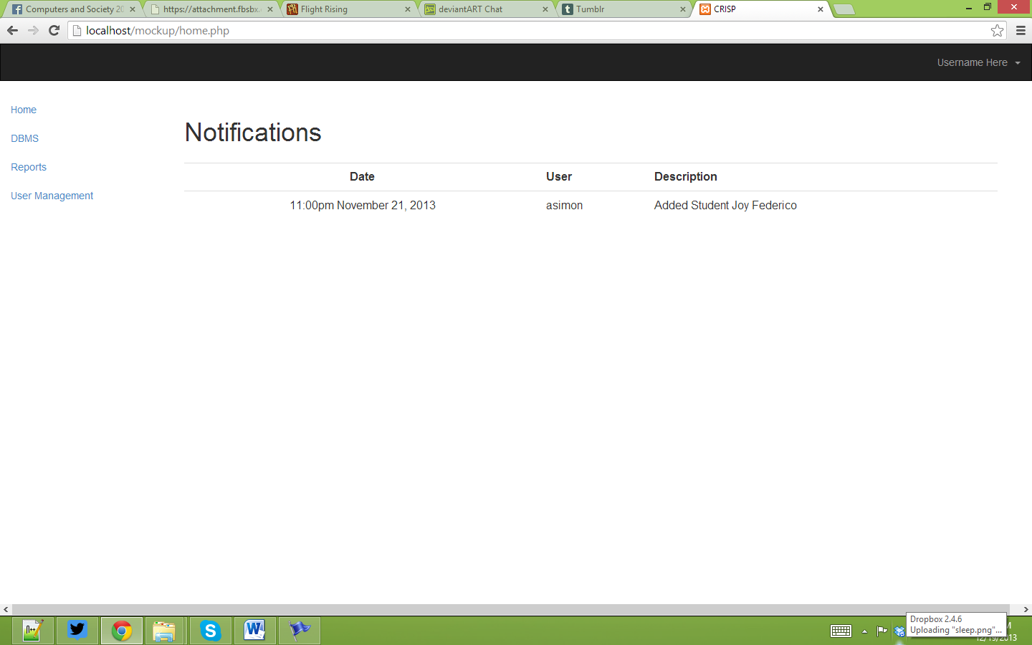

Slide 19
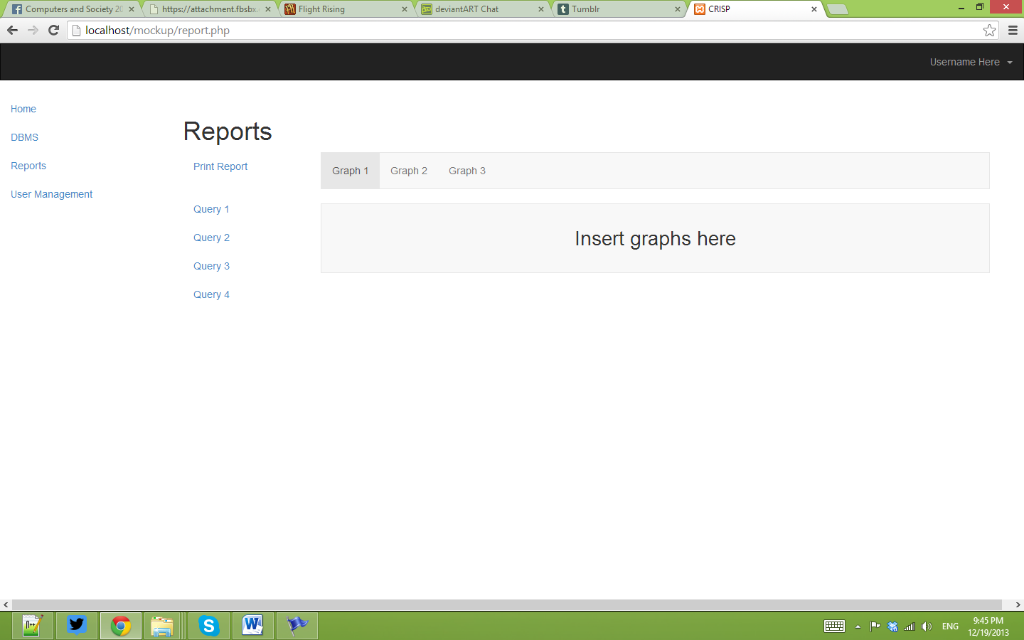

Slide 20
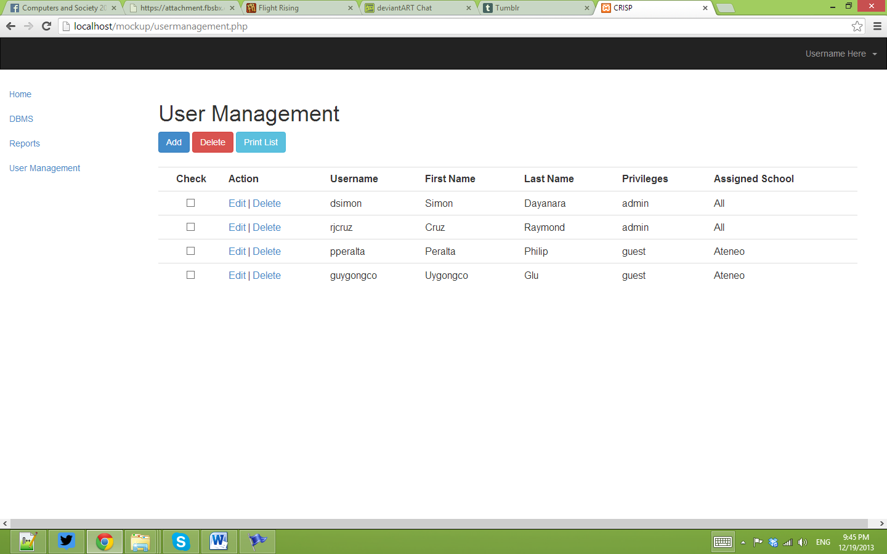

Slide 21
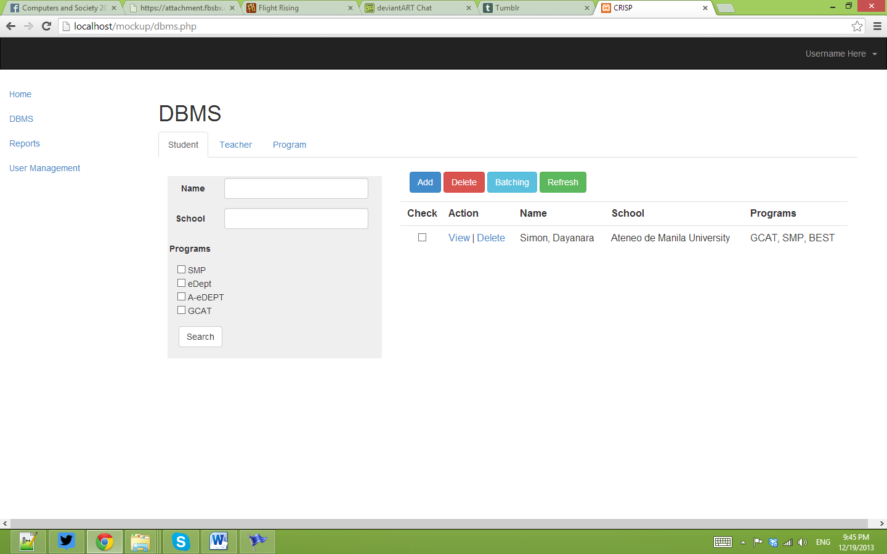

Slide 22
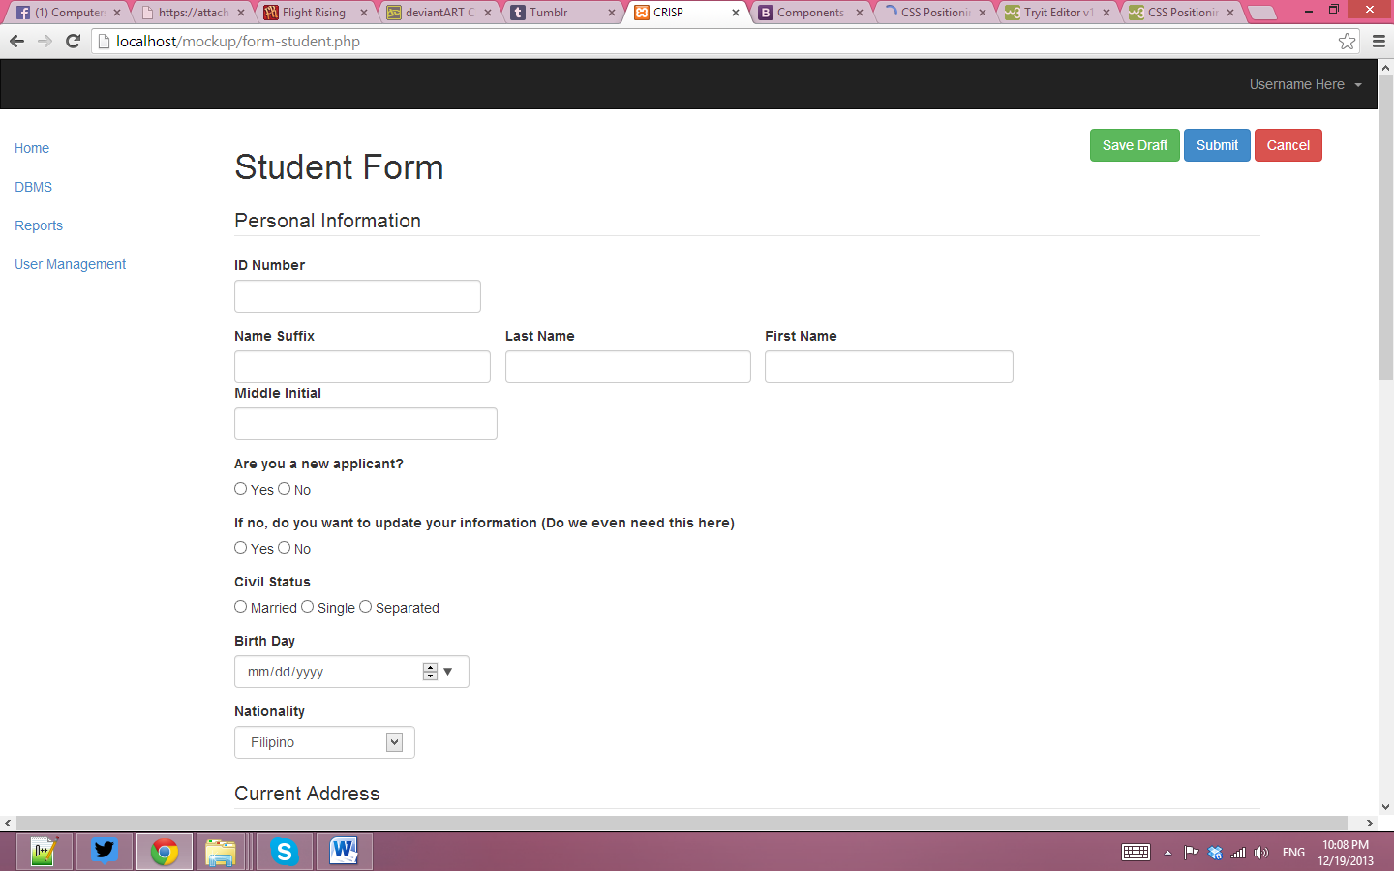

Slide 23
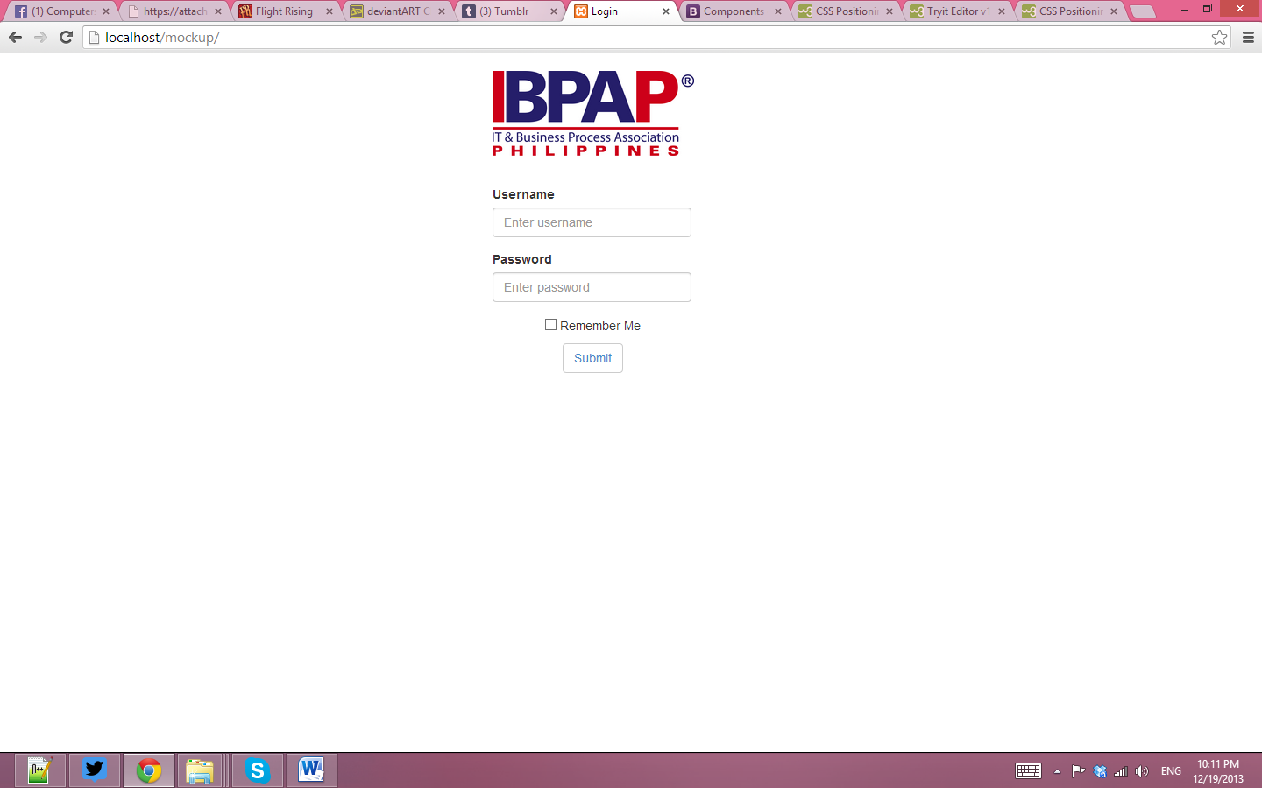

Slide 24
